Slide 1

Revolutionizing Telecom Experiences
TEAM MEMBERS: PAMELA MMUTLANE LINTON KUMALO THANDIWE MTSHWENI LINDOKUHLE MAHLANGU LEBONE MAKHUBEDU

Slide 2
Problem Statement and Significance
Problem Statement:
Retention challenges affect the infrastructure processes in the telecommunications industry,
encompassing issues like unclear contracts, poor customer service, and a lack of accountability.
Why it Matters:
This infrastructure problem is particularly critical as it raises dissatisfaction and confusion, especially for customers
in South Africa's middle to upper class with a monthly income of approximately +-R6000, engaged in 24-month contracts. The absence of clear information weakens trust and highlights the essential need to overhaul the infrastructure that manages contractual processes, aiming for a positive relationship between customers and providers.

Slide 3
Putting a Face to the Problem
User persona
Name: Boitumelo Mogashoa
Gender: Female
Age: 27 years old
Occupation: AWS Architect
Access to technology: high
Education: Computer Science at the University of Johannesburg
Annual Income: R680k
Location: Henely on Klip
User story: In 2019, Boitumelo entered into a contract with MTN and initially found
satisfaction with the services provided.
However, in 2021, when she attempted to upgrade her package,
she encountered difficulties.
Despite making calls and visiting the store, she received no assistance. Towards the end of 2021, she opted to cancel her contract and explore alternative options.
The retention department claimed to have cancelled the contract, yet deductions continue to be made from her account to this day.
Needs:
- Proper understanding of contract
- Thorough explanation of agreements
- A plan which will connect in a different province
- A plan that won’t require much IT knowledge
Challenges:
● Misunderstanding of policies
● Bad customer service
● Inexperienced agent
● Back and forth of the cancellation process
● Miscommunication
● Complex use of words
● Lack of feedback communication
Goals:
● Have a clear policy agreement
● Get assistance from an experienced agent
● Deal with kind, friendly and professional agents
● Have simple words that explain vivid details

Slide 4
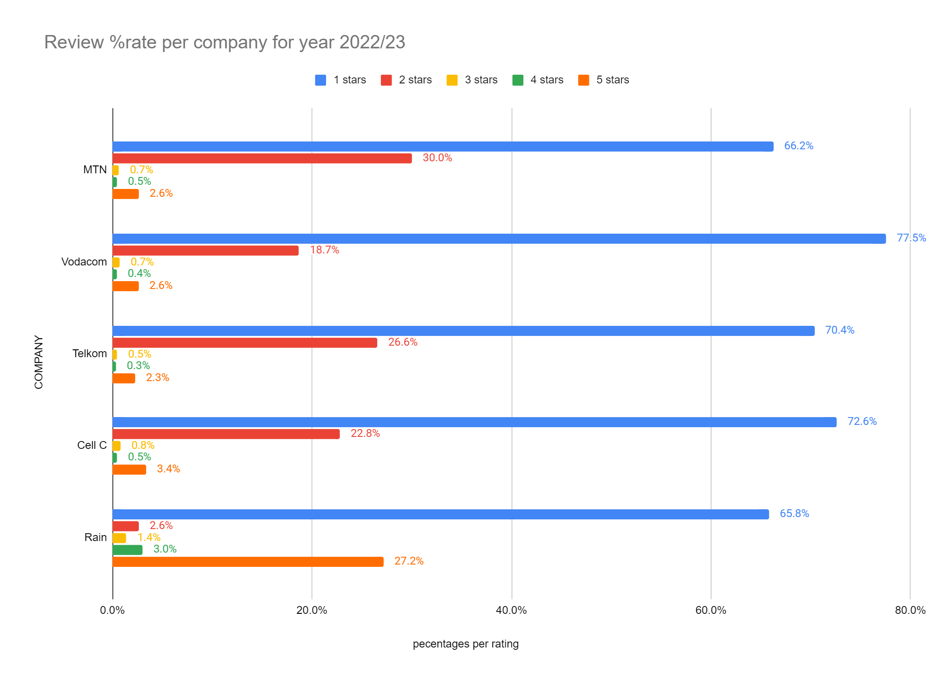
Findings and insights in Telecoms Industry: Review of % rate per company 2022/2023
Source:
https://www.hellopeter.com/mtn/
https://www.hellopeter.com/vodacom
https://www.hellopeter.com/telkom
https://www.hellopeter.com/cell-c
https://www.hellopeter.com/rain-internet-service-provider
In the telecoms industry for the year 2022/23, customer reviews reflect a prevalent dissatisfaction, with most users assigning 1-star ratings across major companies such as MTN, Vodacom, Telkom, and Cell C. These ratings indicate significant room for improvement in enhancing customer experiences. Notably, Rain stands out with a better rating, as a substantial number of users express high satisfaction with 5-star ratings. Overall, the findings underscore the industry's need for improvements in addressing customer concerns and elevating satisfaction levels.

Slide 5
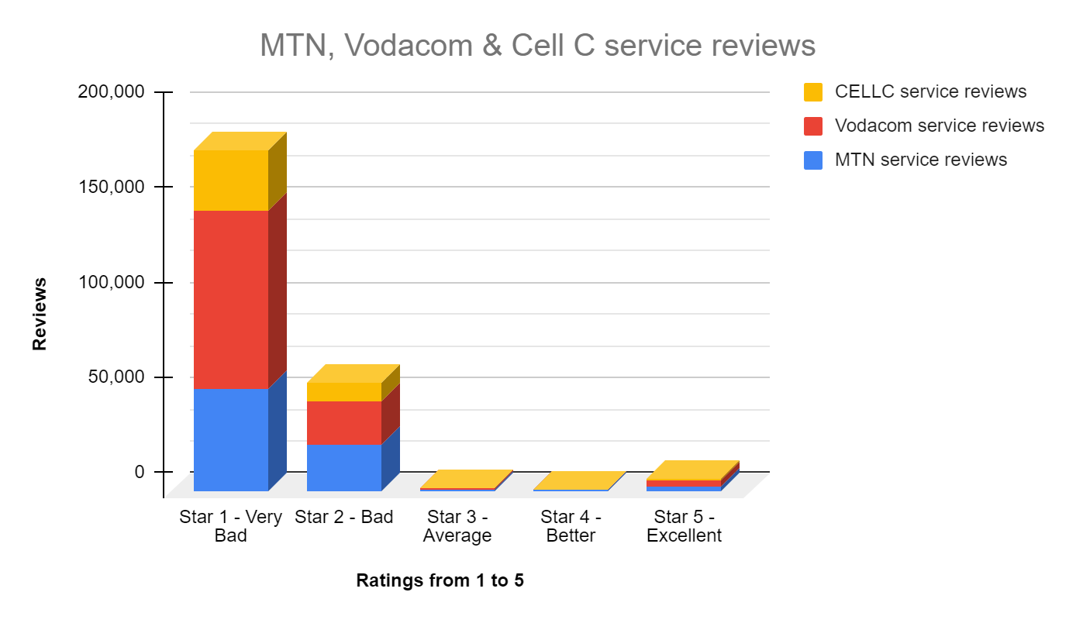
Findings and insights in Telecoms Industry: Service Reviews
Source:
https://www.hellopeter.com/cell-c?page=3978
https://www.hellopeter.com/vodacom?page=10982
https://www.hellopeter.com/mtn?page=1
The service reviews for MTN, Vodacom, and Cell C indicate different levels of customer satisfaction. MTN has accumulated a total of 81,143 reviews spanning with a predominant distribution in the "Very Bad" and "Bad" categories. Vodacom, amassing 120,799 reviews exhibits a more evenly distributed spectrum of star ratings, leaning towards positive reviews. In contrast, Cell C, with 43,749 reviews displays a diverse range of ratings, though it tends to garner fewer reviews overall compared to MTN and Vodacom. The insights suggest that Vodacom enjoys a comparatively better reputation among customers when compared to MTN and Cell C, receiving more favourable reviews in the higher star categories.

Slide 6
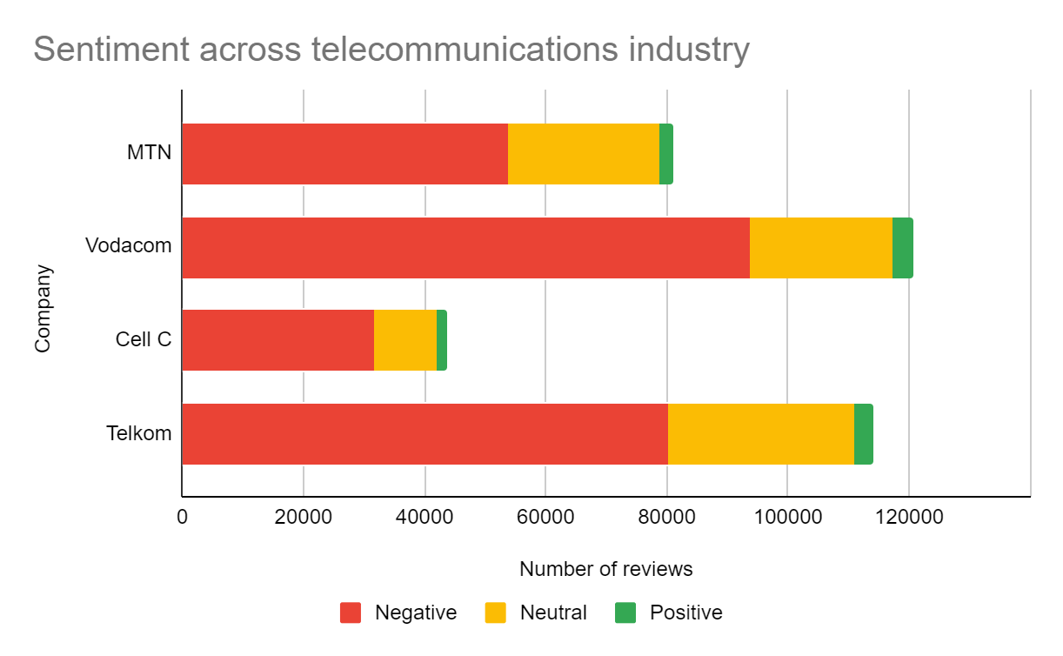
Findings and insights in Telecoms Industry: Sentiment 2022/2023
Source:
https://www.hellopeter.com/mtn/
https://www.hellopeter.com/vodacom
https://www.hellopeter.com/telkom
https://www.hellopeter.com/cell-c
https://www.hellopeter.com/rain-internet-service-provider
Customer sentiment analysis reveals varying degrees of feedback. MTN garnered 53,747 negative, 24,878 neutral, and 2,513 positive reviews. Vodacom experienced a higher volume of negative feedback with 93,670, accompanied by 23,460 neutral and 3,659 positive reviews. Cell C received 31,757 negative, 10,318 neutral, and 1,670 positive reviews. Telkom encountered 80,212 negative, 30,807 neutral, and 2,977 positive reviews. The data highlights the industry's challenge in managing negative sentiments, with companies needing to focus on improving customer experiences to foster positive reviews and overall satisfaction.

Slide 7
Proposed Solution - Revolutionizing Customer Experience
Our Solution: We propose a holistic transformation of the infrastructure managing contractual processes, with a focus on customer-centric revisions. This includes the development of an AI–powered user-friendly app, enhancing communication channels for transparent agreements, and collaborative efforts with telecommunications companies to streamline the cancellation process.
Why This Solution:
Customer-Centric Approach: By placing the customer at the centre, our solution addresses the root cause of dissatisfaction, ensuring a positive and personalized experience for users like Boitumelo Mogashoa.
Enhanced Communication: Transparency in contractual agreements is key. Our solution emphasizes improved communication channels, providing users with a clear understanding of policies and agreements, aligning with Boitumelo's need for a proper understanding of her contract.
User-Friendly App: The development of a user-friendly app is pivotal for widespread adoption. This not only empowers users like Boitumelo but also ensures that individuals with varying levels of IT knowledge can navigate and manage their contracts effortlessly.
Collaboration with Telecom Companies: Establishing collaborative relationships with telecommunications companies is crucial. This collaborative effort facilitates a fast, safe, and transparent cancellation process, addressing the challenges of miscommunication and providing a smoother experience for users.

Slide 8
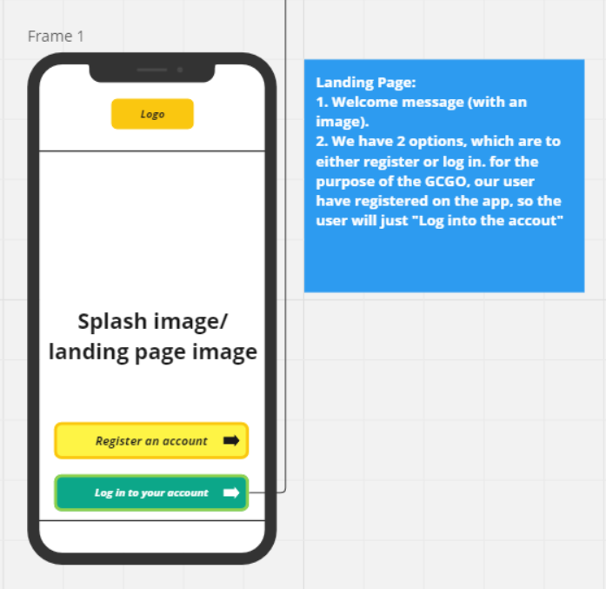
Unveiling the Wireframe Solution
Step 1
Welcome message (with an image).
We offer 2 options: you can either register or log in. For the GCGO, our users have already registered on the app, so you can simply "Log into the account."
This is a video link
https://www.youtube.com/shorts/F1AvGOEz4vw

Slide 9
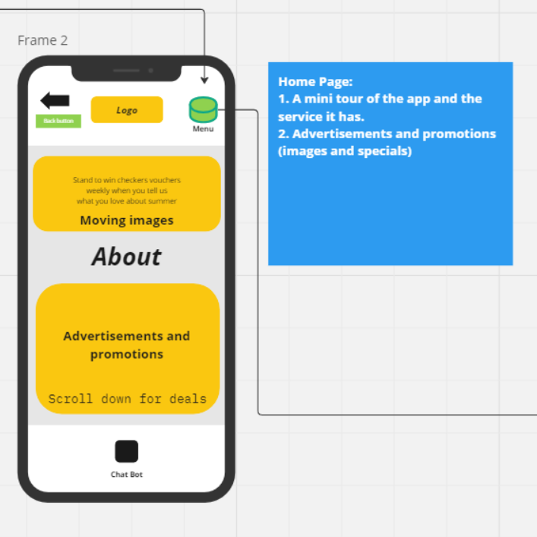
Unveiling the Wireframe Solution
Step 2
A mini tour of the app and the service it has.
Advertisements and promotions (images and specials).
This is a video link
https://www.youtube.com/shorts/F1AvGOEz4vw

Slide 10
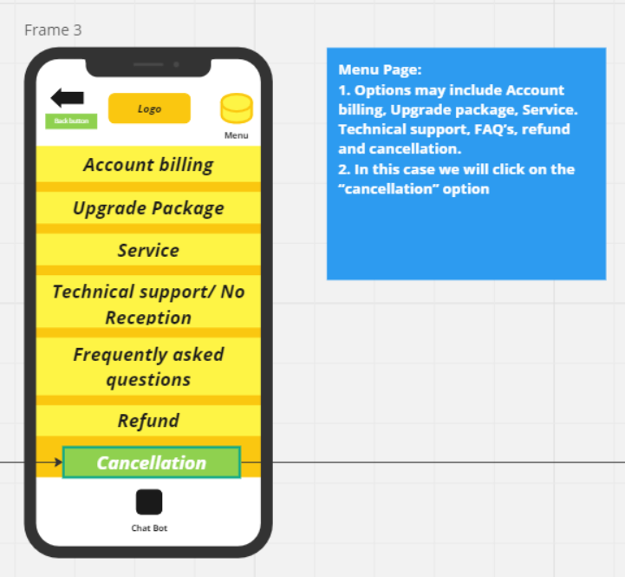
Unveiling the Wireframe Solution
Step 3
Options may include Account billing, Upgrade package, Service. Technical support, FAQ’s, refund and cancellation.
In this case, we will click on the “cancellation” option.
This is a video link
https://www.youtube.com/shorts/F1AvGOEz4vw

Slide 11
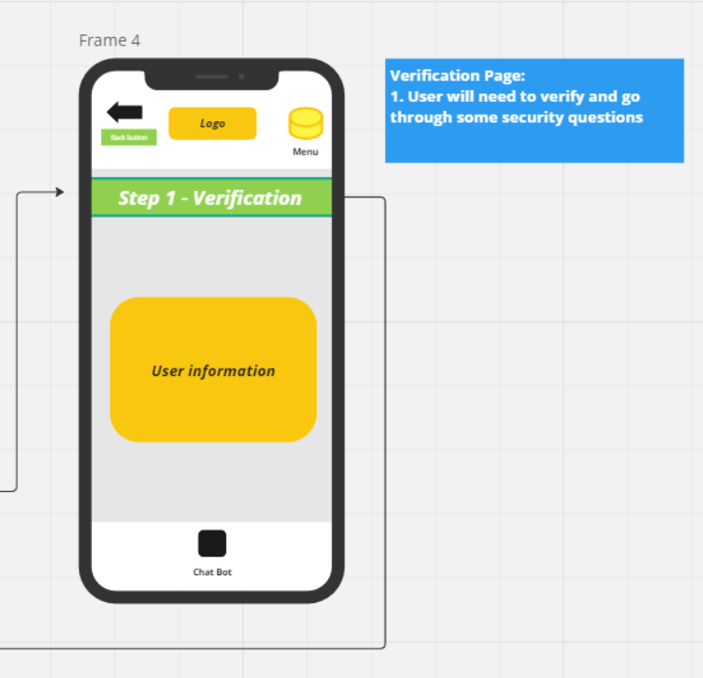
Unveiling the Wireframe Solution
Step 4
User will need to verify and go through some security questions.
This is a video link
https://www.youtube.com/shorts/F1AvGOEz4vw

Slide 12
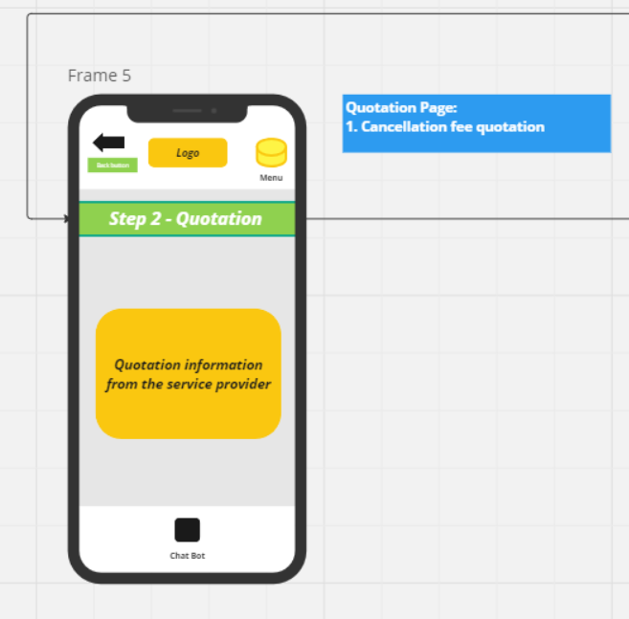
Unveiling the Wireframe Solution
Step 5
Cancellation fee quotation.
This is a video link
https://www.youtube.com/shorts/F1AvGOEz4vw

Slide 13
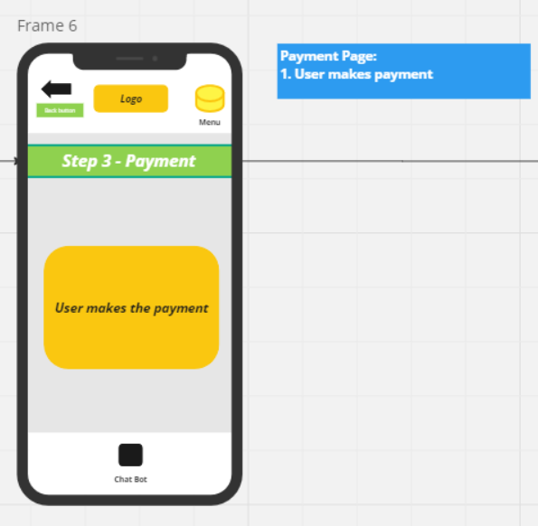
Unveiling the Wireframe Solution
Step 6
User makes payment.
This is a video link
https://www.youtube.com/shorts/F1AvGOEz4vw

Slide 14
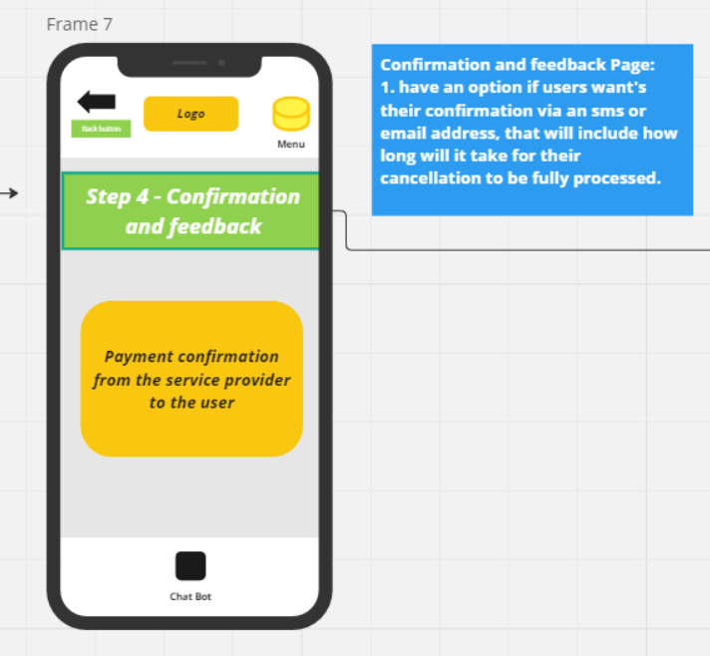
Unveiling the Wireframe Solution
Step 7
have an option if users want their confirmation via an sms or email address, that will include how long will it take for their cancellation to be fully processed.
This is a video link
https://www.youtube.com/shorts/F1AvGOEz4vw

Slide 15
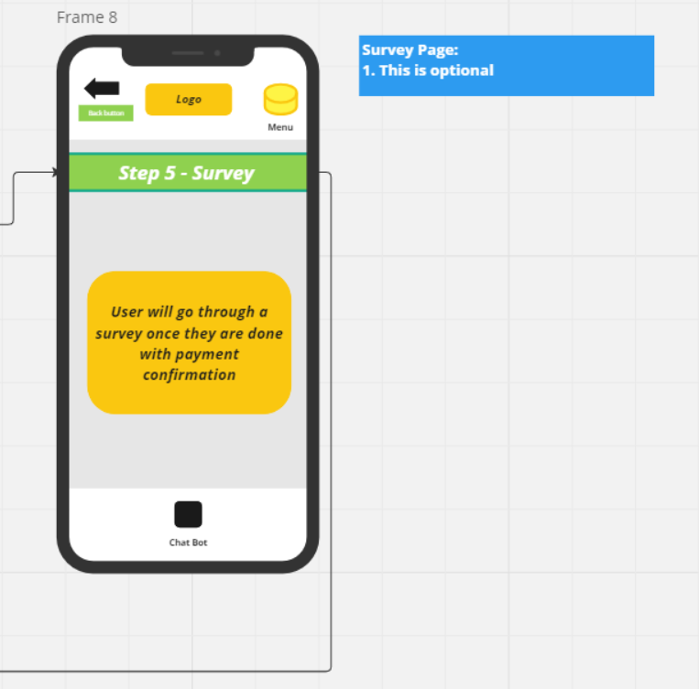
Unveiling the Wireframe Solution
Step 8
This is optional
This is a video link
https://www.youtube.com/shorts/F1AvGOEz4vw

Slide 16
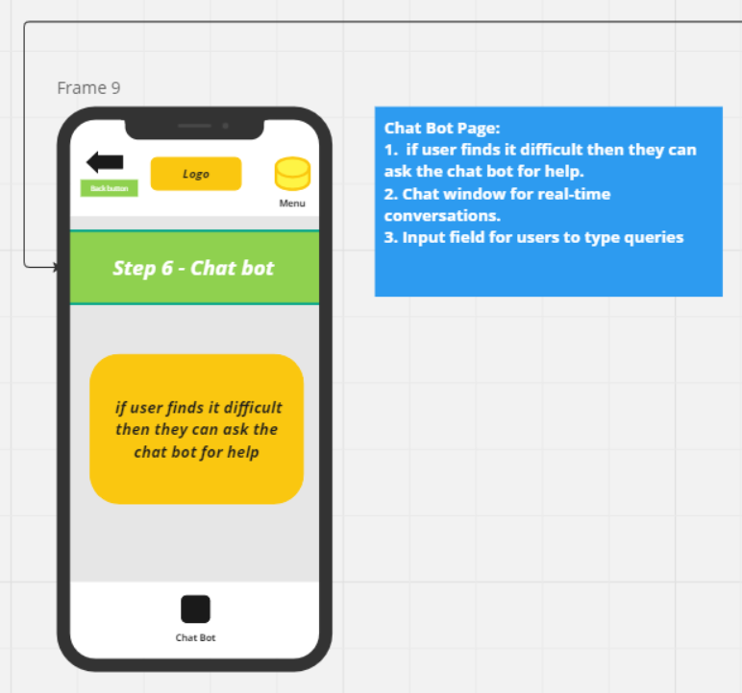
Unveiling the Wireframe Solution
Step 9
if user finds it difficult then they can ask the chat bot for help.
Chat window for real-time conversations.
Input field for users to type queries.
This is a video link
https://www.youtube.com/shorts/F1AvGOEz4vw

Slide 17
User Feedback - Refining the Solution
.
User Needs:
Clear Policy Understanding:
Test users expressed the need for clearer explanations of policy details within the app. Some found certain contract terms confusing and sought a more straightforward presentation.
Efficient Assistance from Agents:
Users emphasized the importance of efficient and knowledgeable customer service agents accessible through the app. They desired quick assistance in resolving queries, especially during complex processes like cancellation.
User Pain Points:
Navigational Challenges:
Some users encountered difficulties in navigating certain sections of the app. This resulted in frustration, highlighting the importance of a seamless user interface.
Cancellation Process Ambiguity:
Users reported confusion during the cancellation process, indicating a need for clearer steps and real-time updates to ensure transparency and avoid miscommunication.

Slide 18
Enhancing Our Solution
Recommendations/Changes:
Improved Navigation:
Based on user feedback highlighting navigational challenges, our team recommends revisiting the app's navigation structure. Implementing clearer pathways and intuitive user flows will enhance overall usability.
Enhanced Customer Support Features:
In response to the need for efficient assistance, we propose integrating advanced customer support features within the app. This includes in-app chat support, instant query resolution, and clear guidance during complex processes like cancellation.
Real-time Updates in Cancellation Process:
Users expressed a desire for real-time updates during the cancellation process. To address this, our solution will incorporate a feature providing users with step-by-step progress updates, ensuring transparency and eliminating ambiguity.
Interactive Policy Explanation:
To address the need for clearer policy understanding, our team suggests incorporating interactive elements within the app that explain complex policies in a user-friendly manner. This could include pop-up tooltips or interactive tutorials for users to grasp details more comprehensively.
Next Steps:
Collaboratively refine wireframes to incorporate changes based on user feedback.
Prioritize the development of customer support features, navigational improvements, and real-time updates during the cancellation process.
Conduct further usability testing to validate the effectiveness of implemented changes and gather additional insights for continuous improvement.

Slide 19
Scaling Our Impact - Future Vision
With Funding, We Envision:
Nationwide Outreach Campaign:
Launch an extensive awareness campaign to reach a wider audience, ensuring that citizens across South Africa are informed about the user-friendly app. Utilize various channels, including social media, partnerships, and community engagement.
Enhanced AI Capabilities:
Integrate advanced artificial intelligence (AI) capabilities within the app to provide personalized assistance, predictive analytics for user needs, and continuous improvements based on user interactions.
Expansion to Additional Telecom Providers:
Collaborate with other major telecom providers to expand the app's coverage, ensuring that a larger portion of the population can benefit from transparent and customer-centric contractual processes.
Multilingual Support:
Implement multilingual support within the app to cater to the diverse linguistic landscape of South Africa. This ensures that all users, regardless of language preferences, can access and understand their contracts seamlessly. This includes integrating a voice function into the app for technologically illiterate and disabled users.
Incorporate Blockchain Technology:
Explore the integration of technology to enhance the security and transparency of contractual processes. This innovation can provide a record of transactions, further building trust between users and telecom providers.
Continuous User Education:
Establish an ongoing user education program, offering tutorials, webinars, and informative content to empower users with a deeper understanding of telecom contracts, ensuring informed decision-making.

Slide 20
Scaling Our Impact - Future Vision: Cont’d..
Impact on South Africa:
Foster a nationwide culture of transparency and fairness in telecommunications contracts.
Empower citizens with the tools and knowledge to make informed decisions about their communication services.
Position South Africa as a leader in user-centric telecommunications infrastructure.
Next Steps:
Assemble a dedicated team to execute the outlined expansion and improvement initiatives.
Collaborate with government bodies, NGOs, and industry stakeholders to amplify the impact.
Continuously gather user feedback and conduct usability testing to ensure ongoing refinement and relevance of the app.

Slide 21
Reinforcing Our WHY
Our WHY revolves around addressing the retention challenges within the telecommunications industry, encompassing issues like unclear contracts, poor customer service, and a lack of accountability. This problem matters because it directly impacts users like Boitumelo Mogashoa, leading to dissatisfaction, confusion, and a potential breakdown of trust between customers and telecommunication providers.
Why Our Solution Matters:
Empowering Users: By transforming the infrastructure governing contractual processes, our solution empowers users with a comprehensive understanding of their contractual terms. This clarity, especially for individuals like Boitumelo, fosters a positive customer-provider relationship.
Building Trust and Transparency: The user-friendly app, enhanced communication channels, and collaboration with telecom companies contribute to a transparent contractual environment. This transparency builds trust, mitigates challenges associated with obscure contract terms, and establishes a foundation for a trustworthy telecom industry.
Nationwide Impact: With the potential for scaling and future innovations, our solution can make a significant difference nationwide. It not only addresses the immediate pain points but also sets the stage for a cultural shift towards user-centric telecommunications practices in South Africa.
User Education and Empowerment: The envisioned user education program ensures that users are not only informed about their contracts but are also equipped with the knowledge to make informed decisions. This educational aspect adds a layer of empowerment, promoting a more informed and engaged user base.

